Slide 1
GREEDY ALGORITHM
Spring 2026
Zhihua Jiang

Slide 2
Content
Applications of greedy algorithms
  Minimum spanning trees
  Huffman encoding
  Set cover
  ……
Optimality proof
  Optimal substructure + Greedy choice
  Matroid

Slide 3
Characteristics of greedy algorithm
Efficient
Easy to implement
Not guarantee an optimal solution
Often used as an approximated algorithm

Slide 4
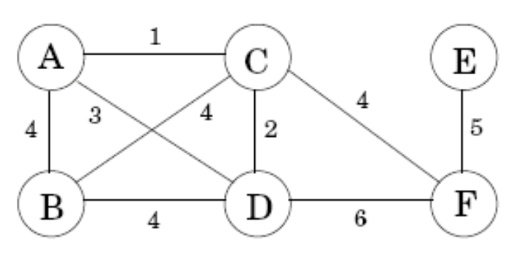
Minimum spanning trees
Real-world applications:
  E.g., how to find the cheapest network?
Property Removing a cycle edge cannot disconnect a graph.
The solution:
  Tree (connected and acyclic)
  Minimum spanning tree (with minimum total weight)

Slide 5
Minimum spanning trees
Trees
  Property 1 A tree on n nodes has n-1 edges.
  Property 2 Any connected, undirected graph G=(V,E) with |E|=|V|-1 is a tree.
  Property 3 An undirected graph is a tree if and only if there is a unique path between any pair of nodes

Slide 6
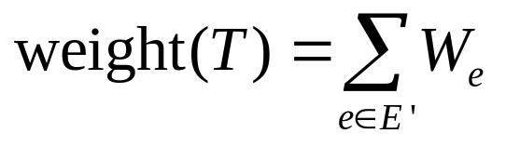
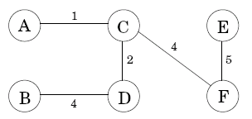
Minimum spanning trees
Minimum spanning tree (MST)
Input: An undirected graph G=(V,E); edge weights W_{e}.
Output: A tree T=(V,E’), with E’⊆E, that minimizes
The MST is not unique!

Slide 7
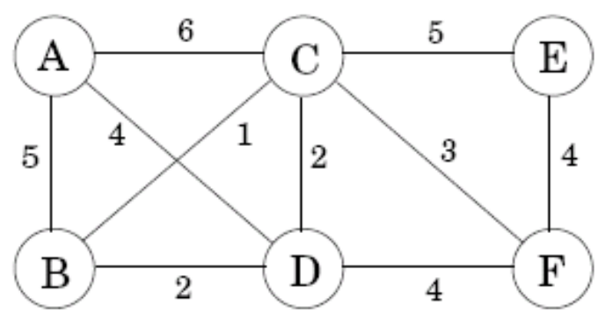
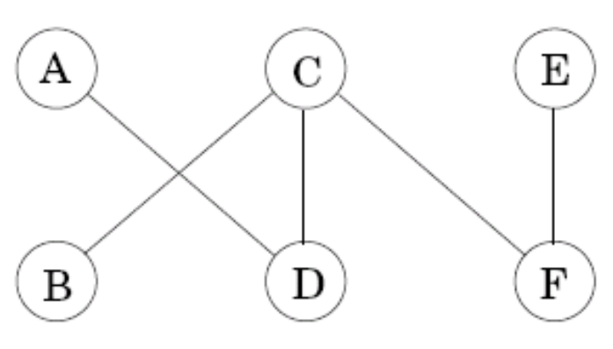
A greedy approach
Kruskal’s MST algorithm:
  Start with the empty graph
  Repeatedly add the next lightest edge that doesn’t produce a cycle
Example: Add edges in increasing order of weight

Slide 8
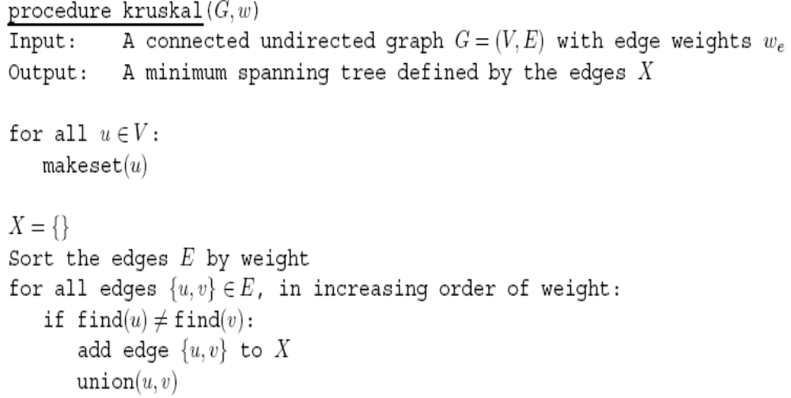

Kruskal’s algorithm
Makeset(x): create a singleton set containing just x
Find(x): to which set does x belong?
Union(x,y): merge the sets containing x and y
Set: connected component
Total work:
|V| makeset, 2|E| find, |V|-1 union
The total time:
O((|V|+|E|)log|V|),
if implemented with disjoint sets

Slide 9
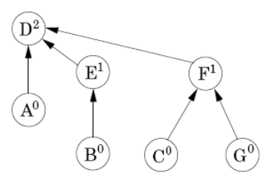
Disjoint set
Why use disjoint sets?
  Contain the nodes of a particular component
How to store disjoint sets?
  A directed tree
  Nodes of the tree are elements of the set
  Each node has a parent pointer that eventually leads up to the root of the tree

Slide 10
Disjoint set
Each node has a parent pointer π and a rank (i.e., the height of the subtree rooted at that node)
Three operations on disjoint sets:
  Makeset(x)
    Make a singleton tree
    O(1)
  Find(x)
    Follow parent pointer to the root of the tree
    O(logn)
  Union(x, y)
    Make the root of the shorter tree point to the root of the taller tree
    The overall height increases only if equally tall
    O(logn)

Slide 11
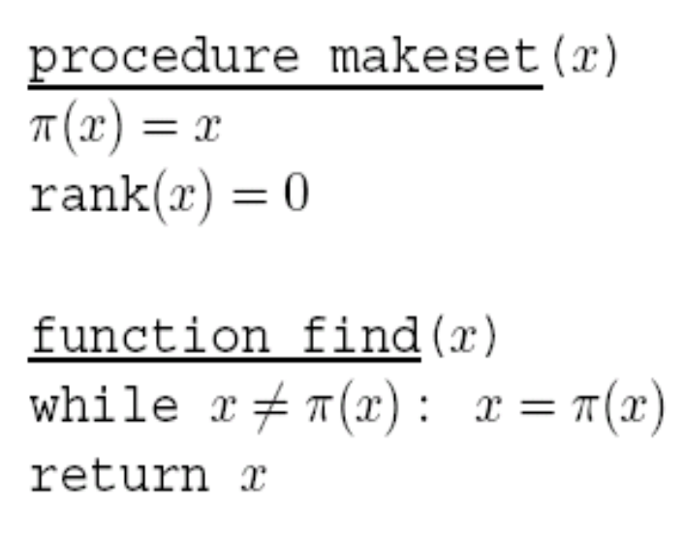
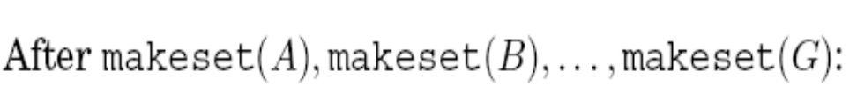
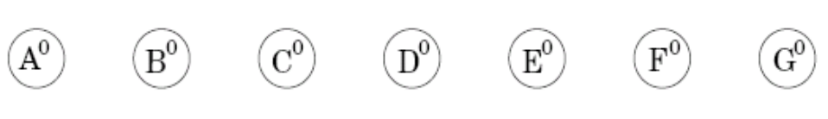
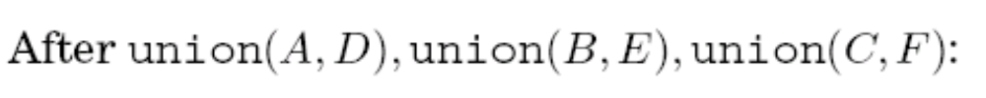
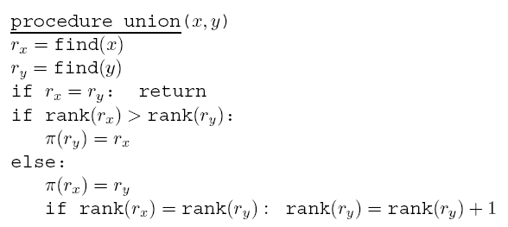
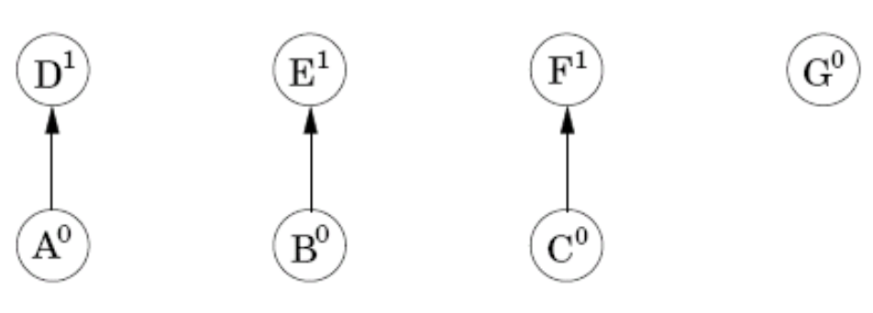

Slide 12

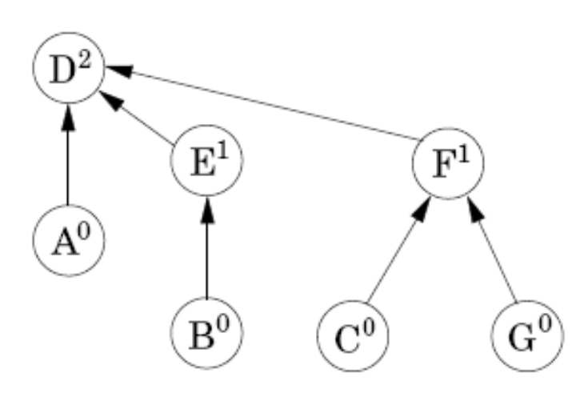

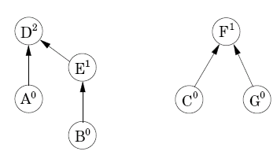

Slide 13
Disjoint set
Property 1 For any x≠π(x), rank(x)<rank(π(x)).
Property 2 Any root node of rank k has at least 2^{k} nodes in its tree.
Property 3 If there are n elements overall, there can be at most n/2^{k} nodes of rank k. (All the trees have height ≤ logn)
Hints:
Property 2 (at least):
  Merge two trees with height k → produce a new tree with height k+1.
Property 3 (at most):
  k=0: n singleton trees with height 0.
  k=1: n/2 single-child trees with height 1.
  Assume when rank = k, the property holds.
  How to produce the most nodes at rank k+1? Merge two trees with height k so that #nodes of rank k+1 is at most (n/2^{k} )/2.

Slide 14
The cut property
Cut: any partition of the vertices into two groups, S and V-S.
Cut property: Suppose edges X are part of a minimum spanning tree of G=(V,E). Pick any subset of nodes S for which X does not cross between S and V-S, and let e be the lightest edge across this partition. Then X ∪ {e} is a part of some MST.
The correctness of Kruskal’s method: it is always safe to add the lightest edge across any cut, provided X has no edges across the cut.

Slide 15
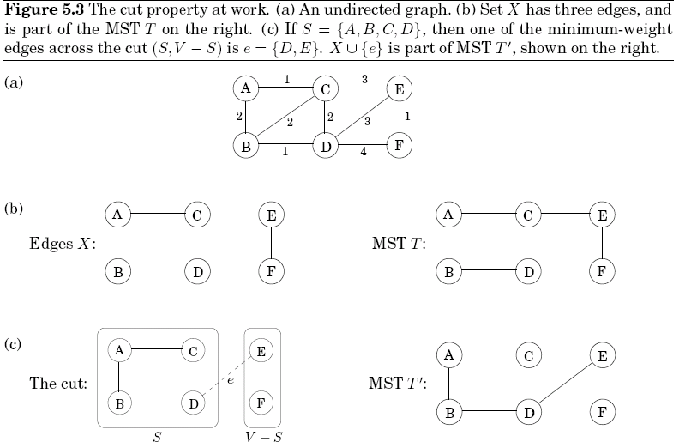
5.1.2 The cut property

Slide 16
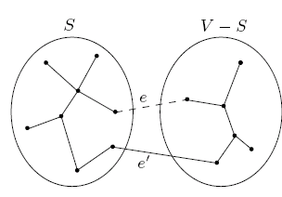
The cut property
Proof of the cut property
  Assume X is part of some MST T, and e is not in T
  Construct a different MST T’ containing X ∪ {e}
    Adding e to T will create a cycle
    T’=T∪{e}-{e’}
    T’ has the same number of edges as T, so T’ is a tree
    weight(T’)=weight(T)+w(e)-w(e’), since w(e)≤w(e’), weight(T’) ≤ weight(T). T’ is also a MST.

Slide 17
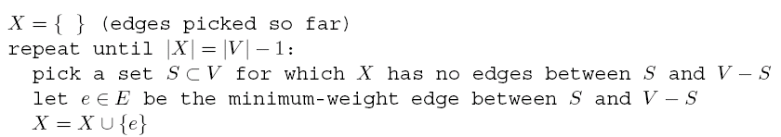
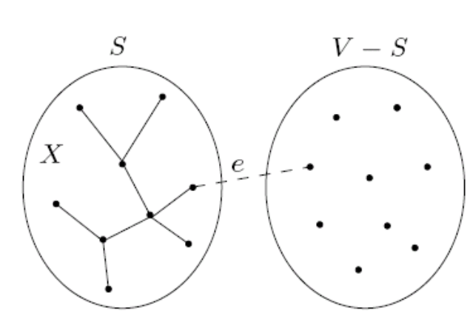
Prim’s algorithm
The following greedy schema always works for finding MST:
Prim’s algorithm: X always forms a subtree, and S is the set of this tree’s vertices

Slide 18
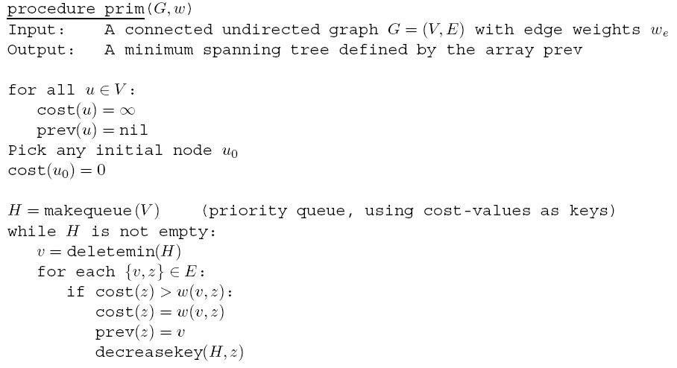

Similar to Dijkstra’s algorithm, except that the key value is the weight of the lightest outgoing edge from set S, while in Dijkstra’s it is the length of an entire path from start node to the node
The time complexity: O((|V|+|E|)log|V|)

Slide 19
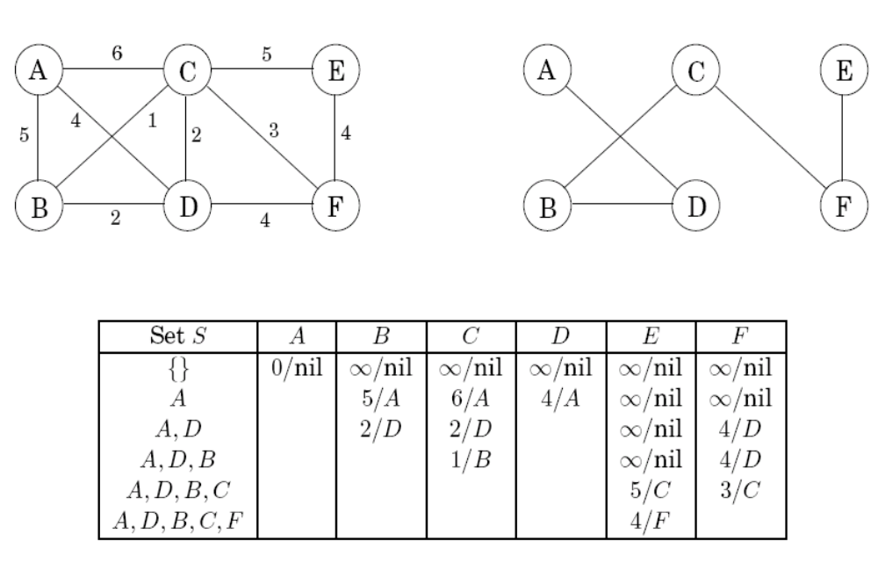
5.1.5 Prim’s algorithm
Notes:
Can we discard prev?
No.
A-1-B-1-C-100-D
A-3-D

Slide 20
Comparison
 | Kruskal | prim
sort all edges?
mimimum
data structure
time complexity

Slide 21
Comparison
 | Kruskal | prim
sort all edges? | yes | no
minimum | the lightest edge in the remaining edges | the lightest edge among the cross edges
data structure | disjoint set (connected component) | binary heap (priority queue)
time complexity | O((|V|+|E|)log|V|) | O((|V|+|E|)log|V|)

Slide 22
Huffman encoding
The introductory example:
A long string of length T = 130 million, an alphabet Γ consists of just four symbols A, B, C, D, how to encode in the most economical way?
  Uniform-length encoding
    00 for A, 01 for B, 10 for C, 11 for D
    260 megabits are needed in total
  Variable-length encoding
    One bit for the frequently occurring symbol, while two or more bits for less common symbols
    Cause ambiguity
    Prefix-free property: no codeword can be a prefix of another codeword

Slide 23
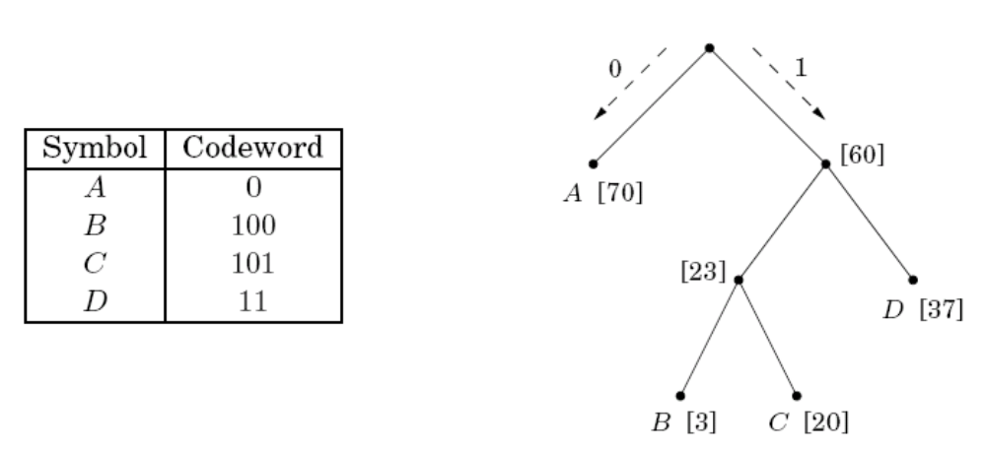
Huffman encoding
Prefix-free encoding:
  Represented by a full binary tree
  Symbols are at the leaves
  Codeword: a path from root to leaf, interpreting left as 0 and right as 1
  For the introductory example, drop to 213 megabits, a (260-213)/260 = 18% improvement

Slide 24
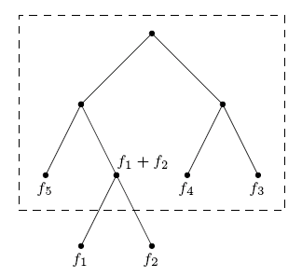
Huffman encoding
How to find the optimal coding tree, given the frequencies f₁,f₂,…,f_{n} of n symbols?
  Define the frequency of any internal node to be the sum of the frequencies of its descendant leaves
  Construct the tree greedily:
    Find the two symbols with the smallest frequencies f₁ and f₂
    Pull f₁ and f₂ off the list of frequencies, insert (f₁ ＋ f₂), and loop

Slide 25
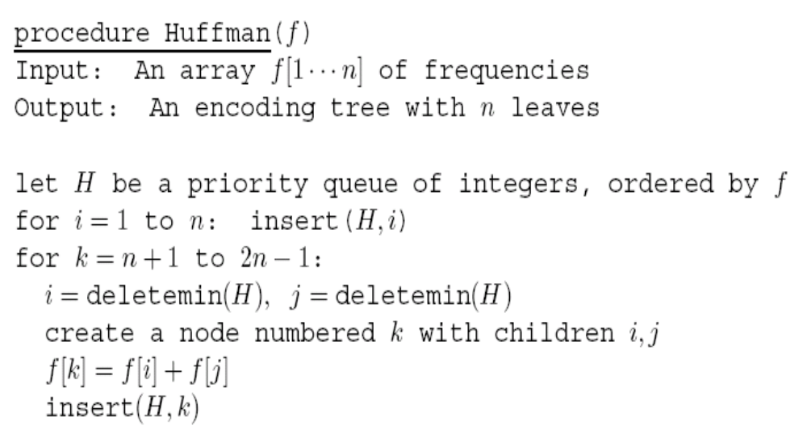
Huffman encoding
Use priority queue
Take O(nlogn) time if a binary heap is used

Slide 26
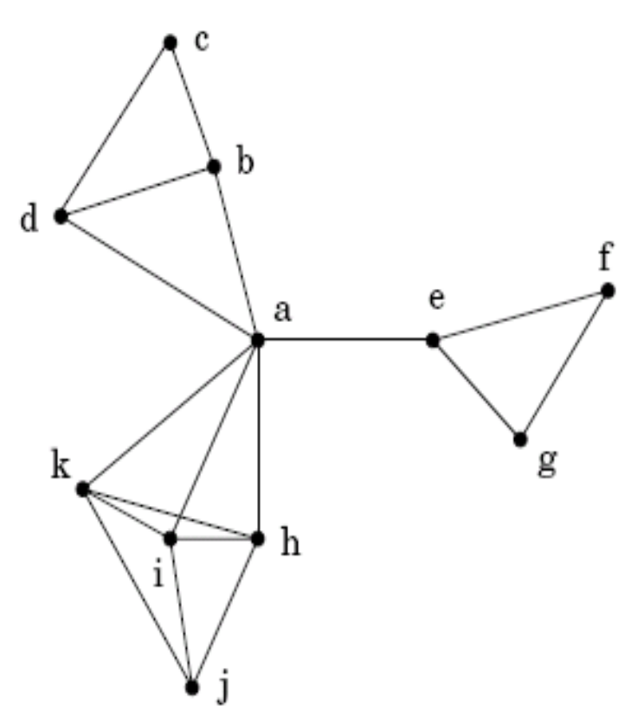
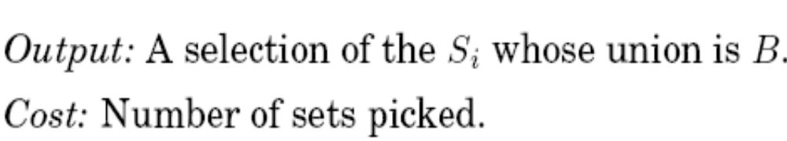
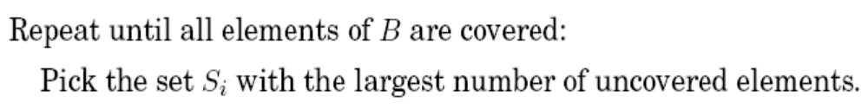
Set cover
The set cover problem:
A greedy algorithm:
A greedy solution{S_{a}, S_{c}, S_{j}, S_{f}} where S_{a}=Adj(a)∪{a}
An optimal solution{S_{b}, S_{e}, S_{i}}

Slide 27
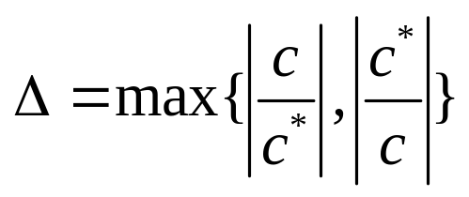
Set cover
Claim: Suppose B contains n elements and that the optimal cover consists of k sets. Then the greedy algorithm will use at most klnn sets.
Approximation factor: the ratio between the optimal value c of the approximation solution and that c* of the optimal solution.
The closer the approximation factor is to one, the better the approximation algorithm performs.

Slide 28
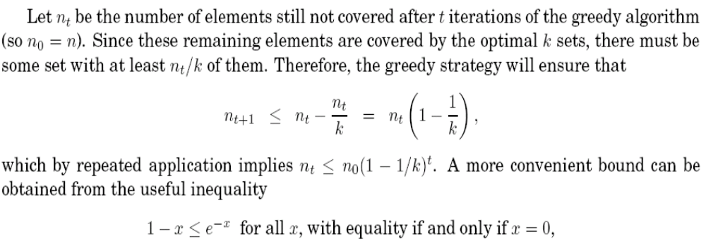
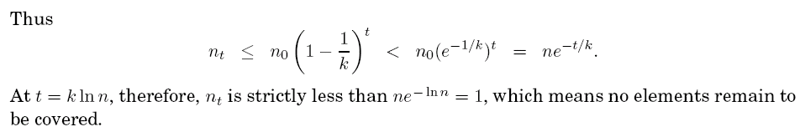
Claim: Suppose B contains n elements and that the optimal cover consists of k sets. Then the greedy algorithm will use at most klnn sets.
Proof
Notes:
reciprocal

Slide 29
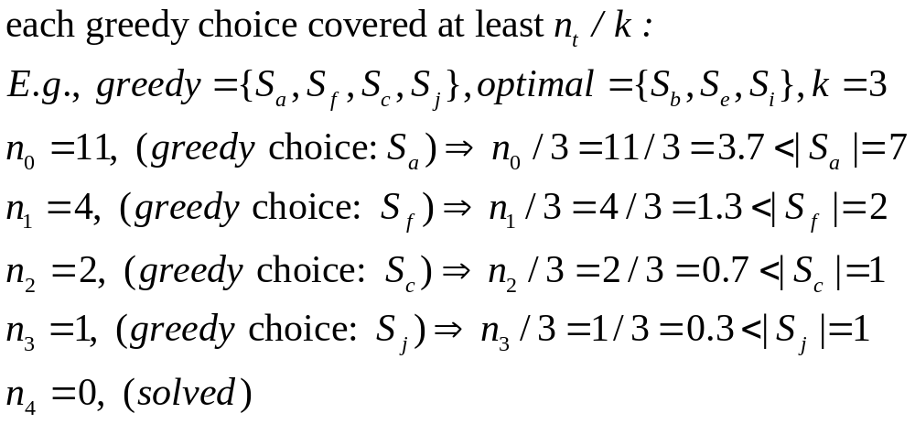

Slide 30
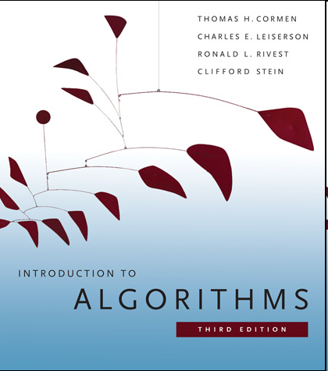
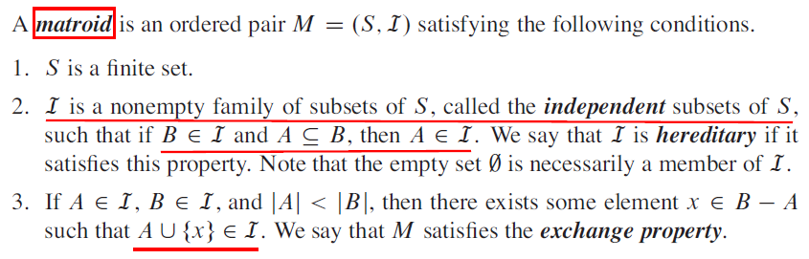
Matroid theory: See CLRS book (Chapter 16.4)
Notes:
Matroid [mə'trɔɪd]
Hereditary [həˈredɪtri]
Inherited [ɪn'herɪtɪd]
heritance

Slide 31
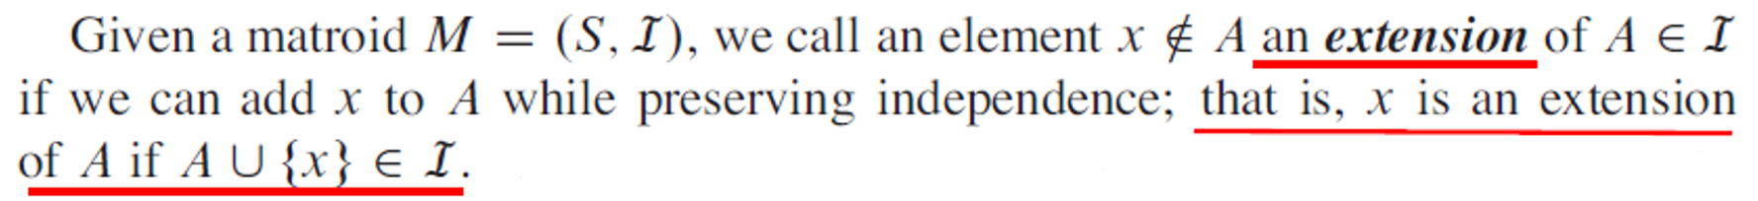
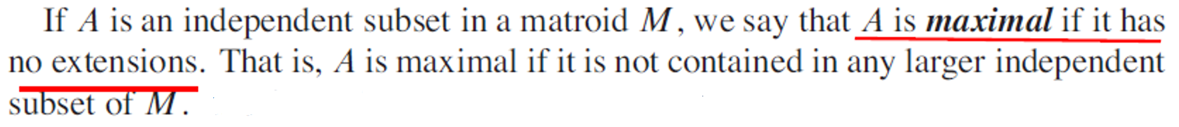
Notes:
if does not exist such x -> foreach x in B-A, A+{x} is cyclic -> two endpoints of x must be in V_A -> V_B=V_A -> B is cyclic

Slide 32
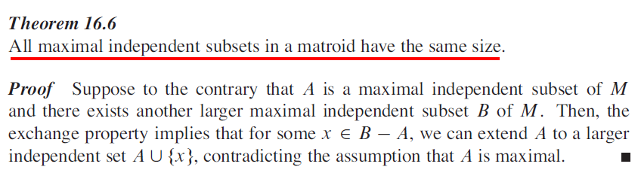
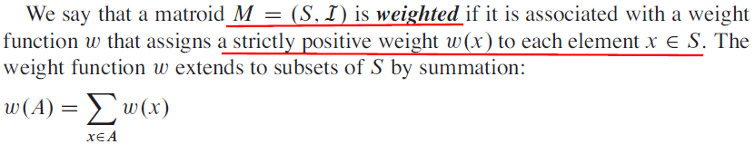

Slide 33
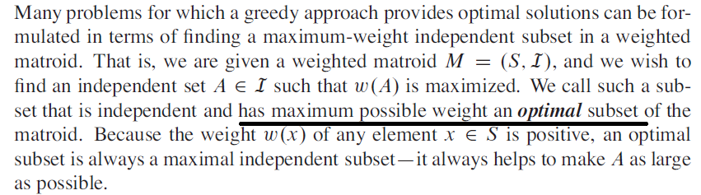
Notes:
猛烈

Slide 34
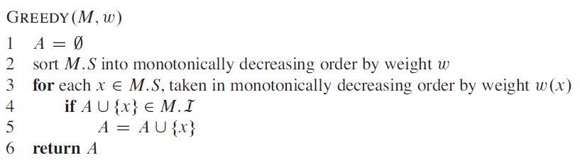
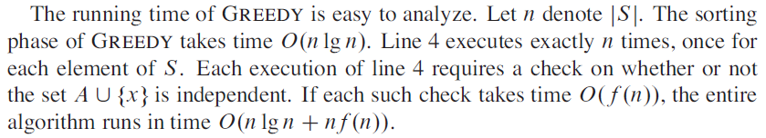
Notes:
Monotonically [mɒnə'tɒnɪklɪ]
List all subsets: O(2^n)

Slide 35
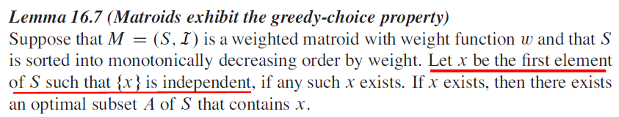
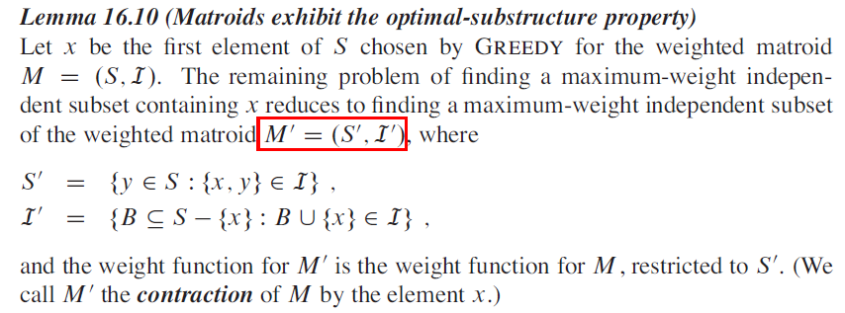
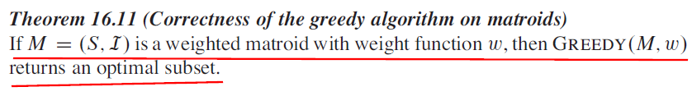

Slide 36
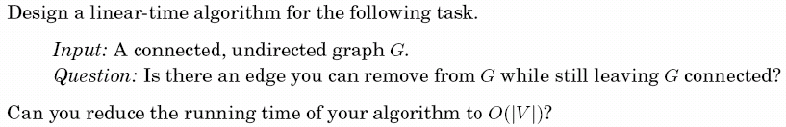
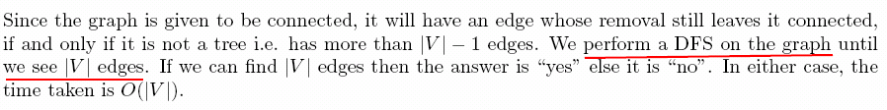
Ex. 1

Slide 37
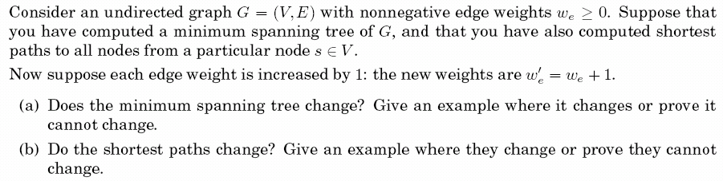
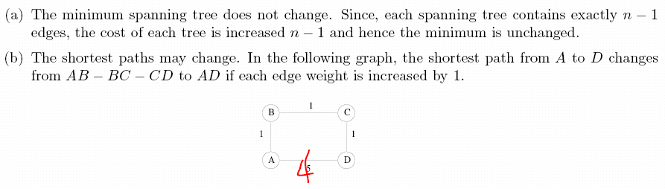
Ex. 2
4

Slide 38
Ex. 3

Slide 39
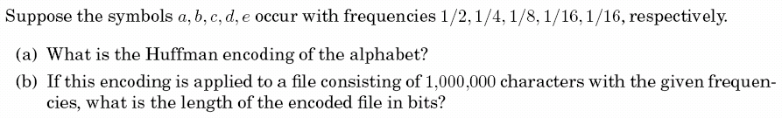

Ex. 4

Slide 40
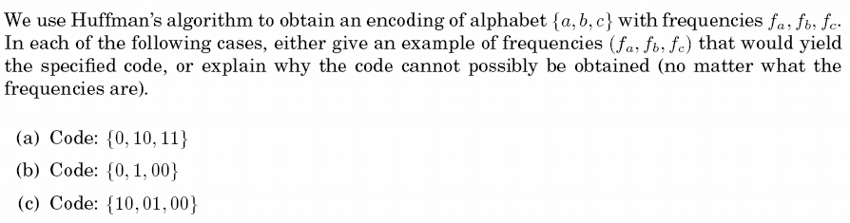
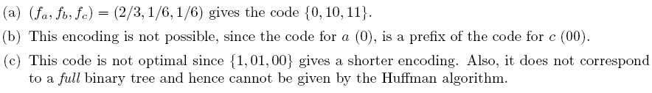
Ex. 5

